Slide 1

Match to Rank Model for Personalized Click-Through Rate Prediction
AAAI 2020 oral
Presented by Ju Xin

Slide 2
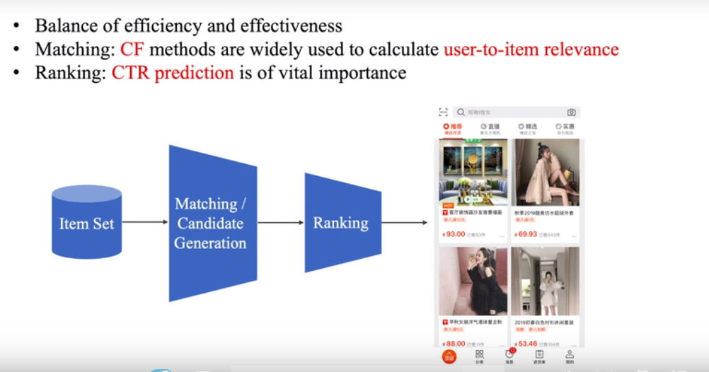
背景
Balance of efficiency and effectiveness
Matching: CF methods are widely used to calculate user-to-item relevance
Ranking: CTR prediction is of vital importance

Slide 3
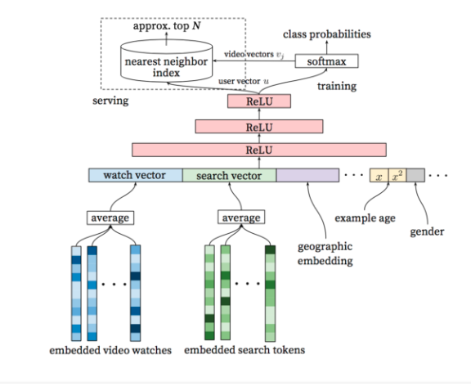
相关工作
Matching
Deep Neural Network for YouTube Recommendation 2016 Google

Slide 4
相关工作
Ranking
Deep learning based CTR prediction model
Model capability
Implicit high-order feature interactions
Generalization: low-dimensional representation from high-dimensional sparse feature
Feature interaction network
wide& Deep
PNN
DeepFM AFM NFM
User interest representation network
DIN--user interest
DIEN--sequential information in user behavior

Slide 5
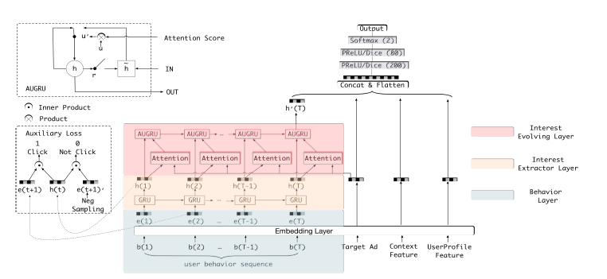
相关工作
Ranking
Deep learning based CTR prediction model
Model capability
Implicit high-order feature interactions
Generalization: low-dimensional representation from high-dimensional sparse feature
Feature interaction network
wide& Deep
PNN
DeepFM AFM NFM
User interest representation network
DIN--user interest
DIEN--sequential information in user behavior

Slide 6
Motivation and Contribution
Motivation
User-to-item relevance is of vital importance
directly measures the intensity of user's preference on target item.
Existing works pay less attention on representing the user-to- item relevance.
Contributions
Collaborative filtering in matching methods to represent the user-to-item relevance
User-to-Item Network
Item-to-Item Network
Jointly train matching and ranking in CTR prediction
Introduce positional encoding to learn the weight for each behavior---sequential information

Slide 7
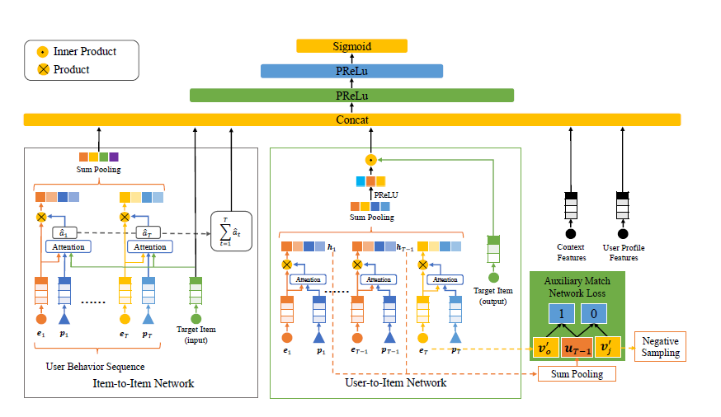
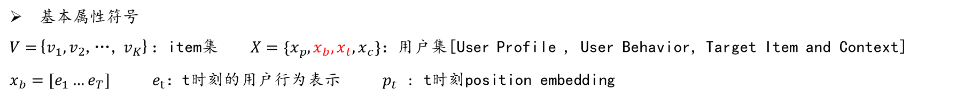
模型
Item-item相似度
user-item交互
基本属性符号
$V=${$v_{1},v_{2}$,…, $v_{K}$}：item集 $X=\{x_{p},x_{b},x_{t},x_{c}\}：$用户集[User Profile , User Behavior, Target Item and Context]
$x_{b}=[e_{1}…e_{T}]$ $e_{t}：$t时刻的用户行为表示 $p_{t}$ : t时刻position embedding

Slide 8
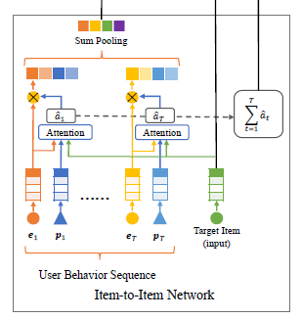


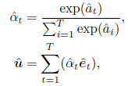


模型
Item-to-item Network
和目标商品更相似的用户行为商品获得更高的权重
Model the similarity between user interacted item and target item--- item-to-item relevance
add them up to obtain another kind of user-to-item relevance.
Target-relevant user representation
$$\hat{u}$$
$$\hat{r}$$
temporal interest representation
$p_{t}$:位置编码行为序列按时间顺序排列后的编号，表达行为时间的远近 [参考文献：transformer]

Slide 9

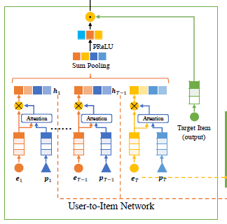



模型
User-to-item Network
Model user-to-item relevance directly by inner product of corresponding representation
Auxiliary match network
$$r$$

Slide 10
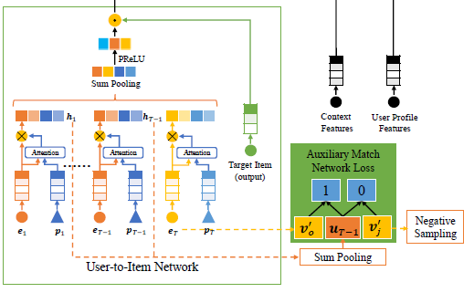

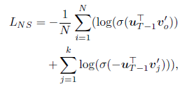

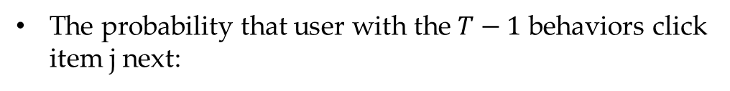
模型
User-to-item Network
从反向传播的角度来看，仅通过点击标签的监督很难确保V的学习
Auxiliary match network : push larger inner product to represent relevance
The probability that user with the $T−1$ behaviors click item j next:
apply the negative sampling technique
The final loss

Slide 11

实验
预测能力
对比实验
LR
Wide & Deep
FNN
DIN、DIEN
指标
AUC--AUC越接近1.0，检测方法真实性越高
数据集
Alimama Dataset
Online $recommender system in Alibaba$

Slide 12
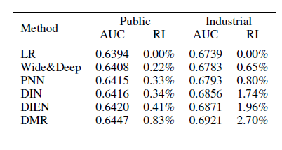
实验
对比实验
DMR outperforms the state-of-art models significantly

Slide 13
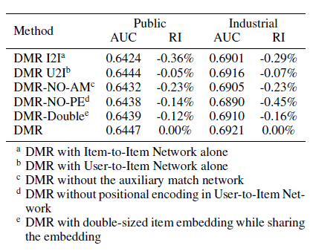
实验
各组件重要性
User-to-item network、auxiliary match network及positional encoding有重要作用

Slide 14
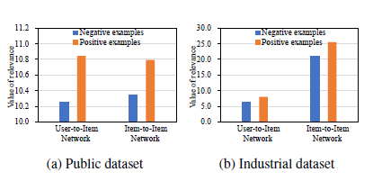
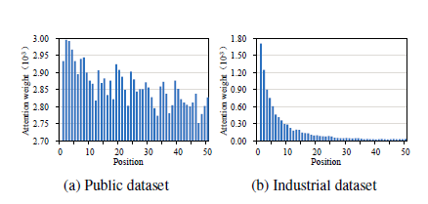
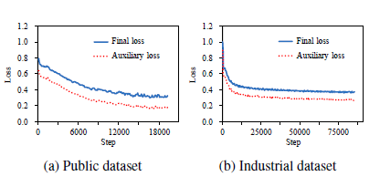
实验
对比实验
User-to-item relevance
Attention weights with regard to different positions
in Item-to-Item Network.
More recent behavior has smaller position number.
Both losses are training losses, where auxiliary loss is LNS, and is set to 0.1.

Slide 15
规格严格，功夫到家
感谢聆听指正

